Slide 1


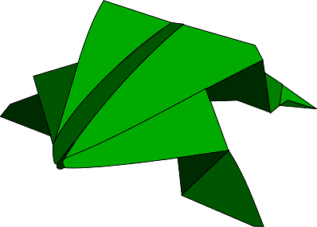


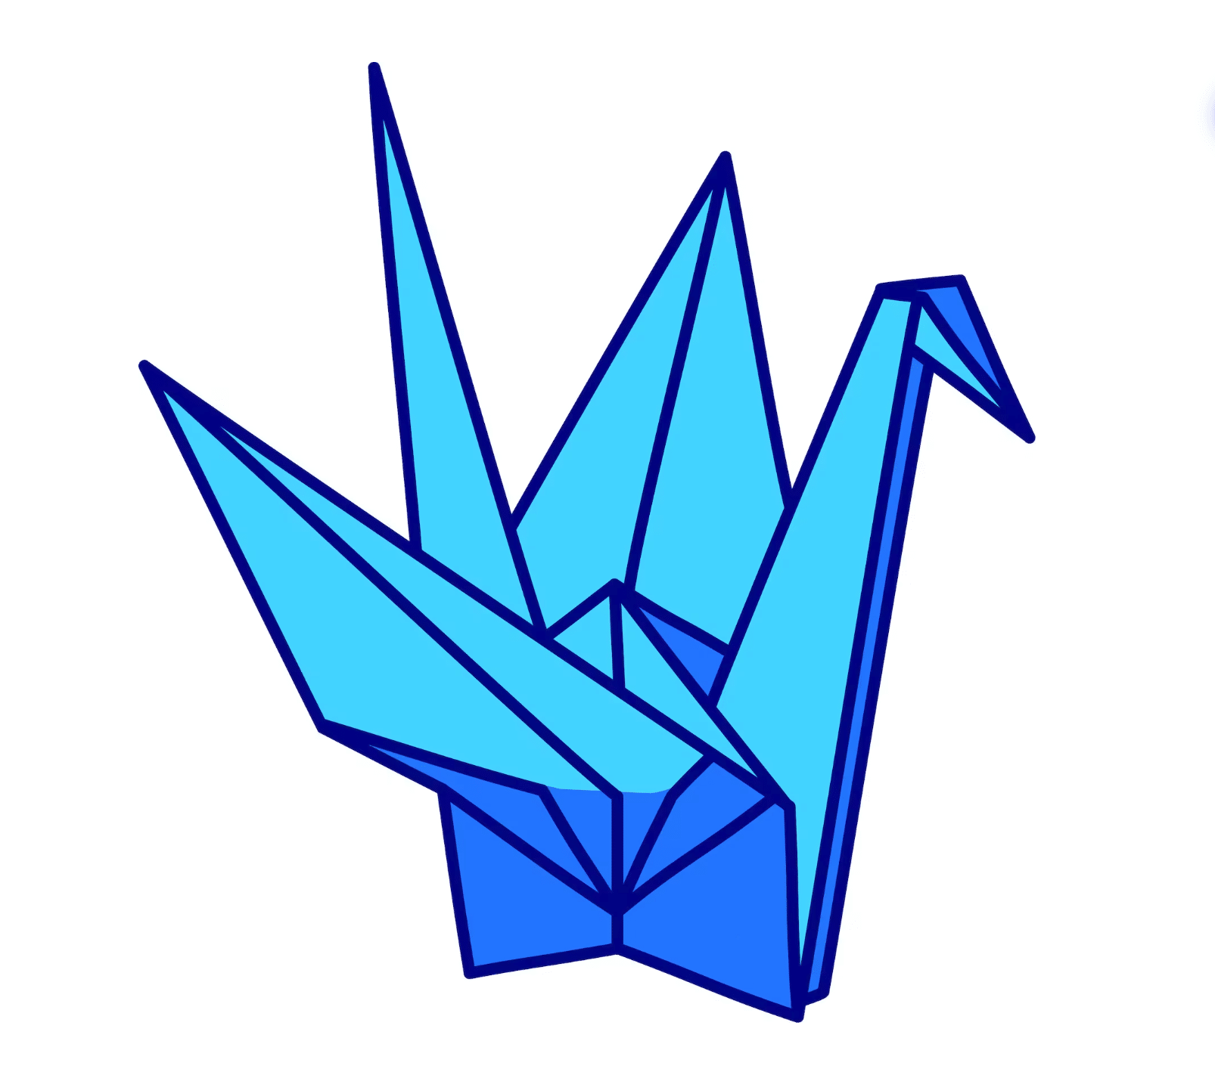
Art Meets Technology: The Birth of…

Slide 2
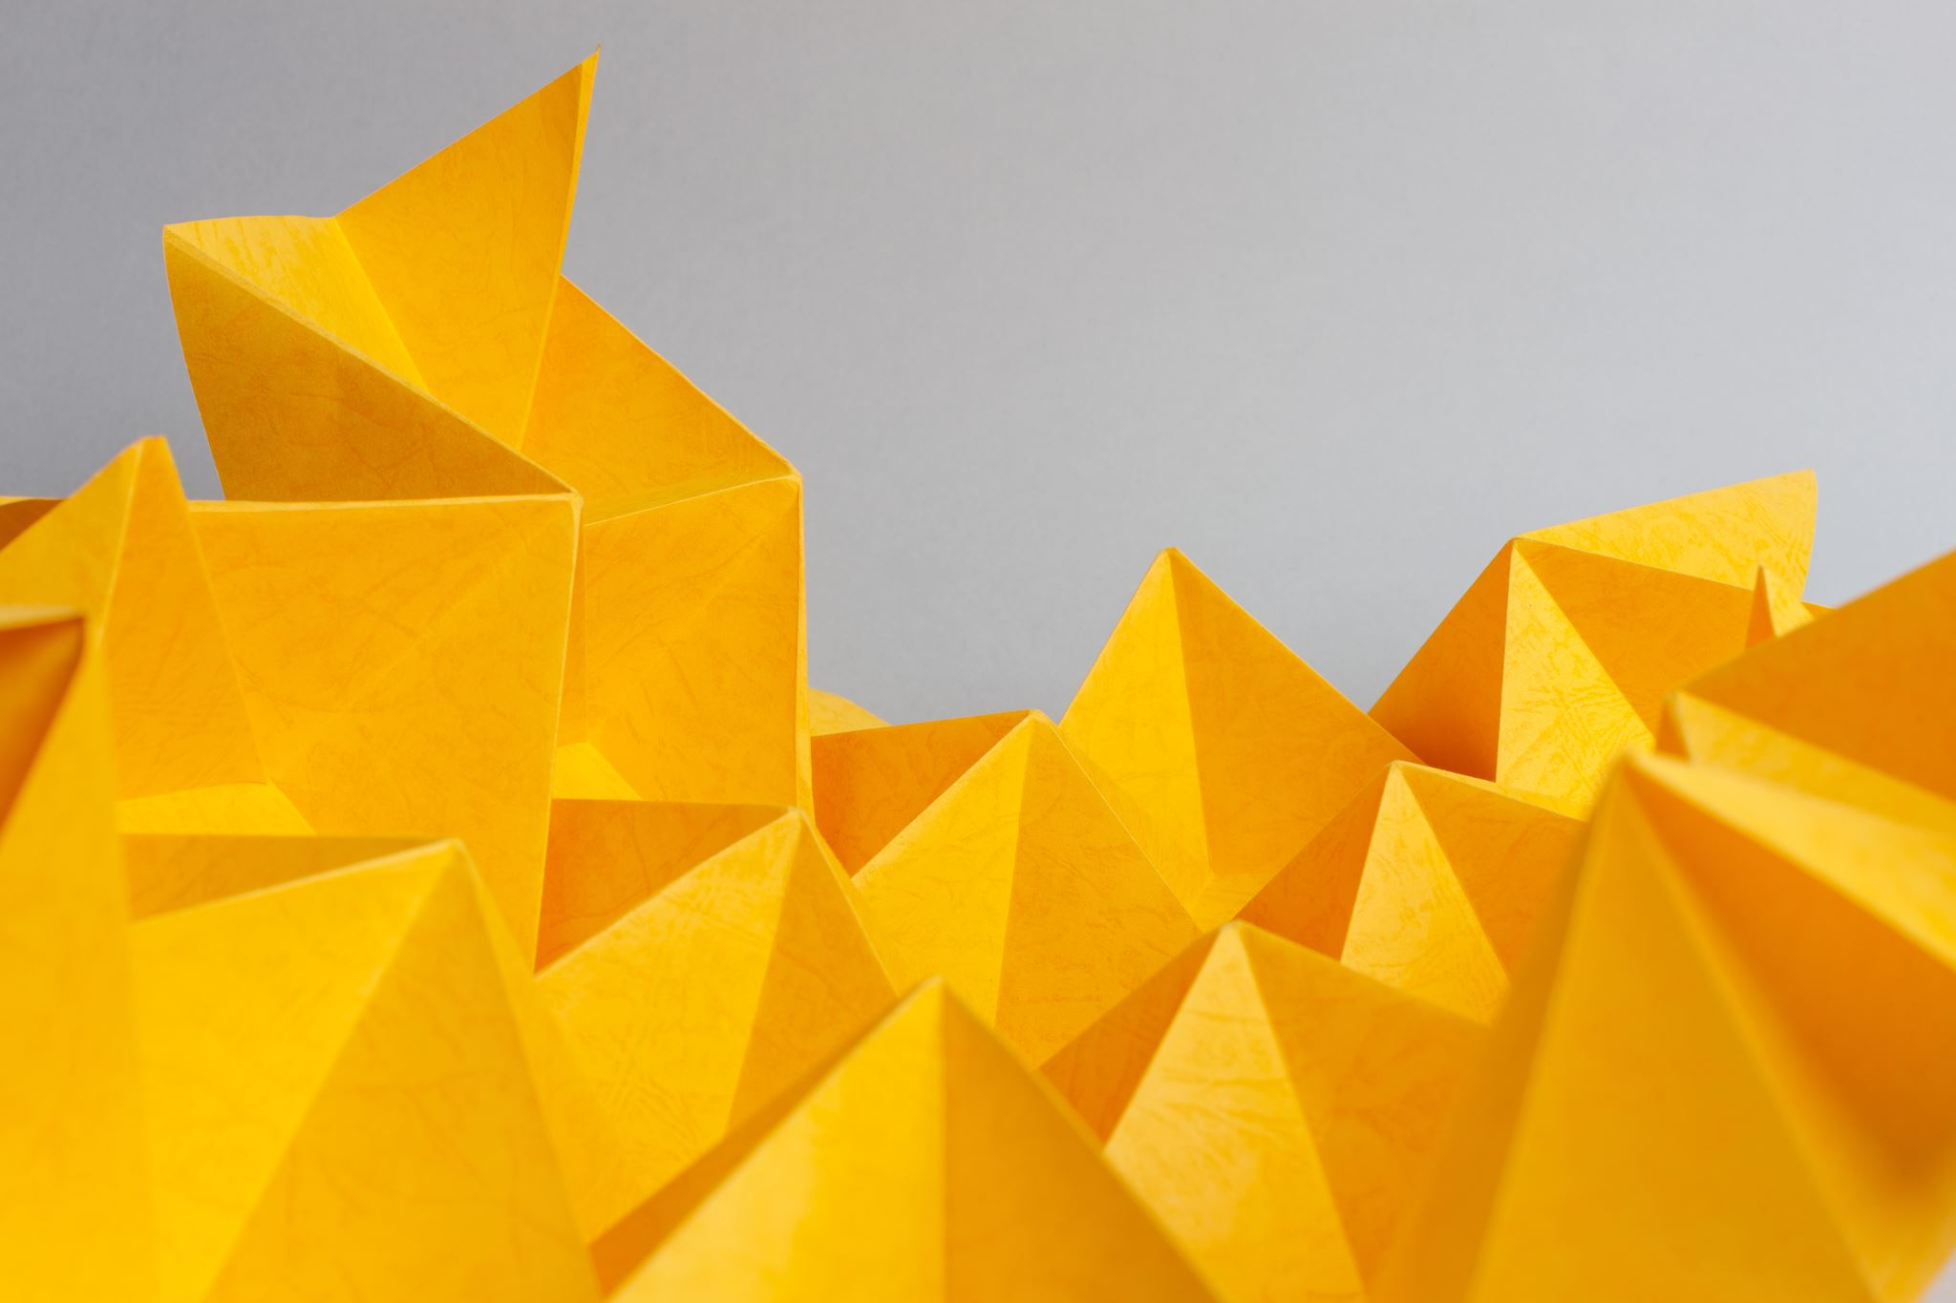

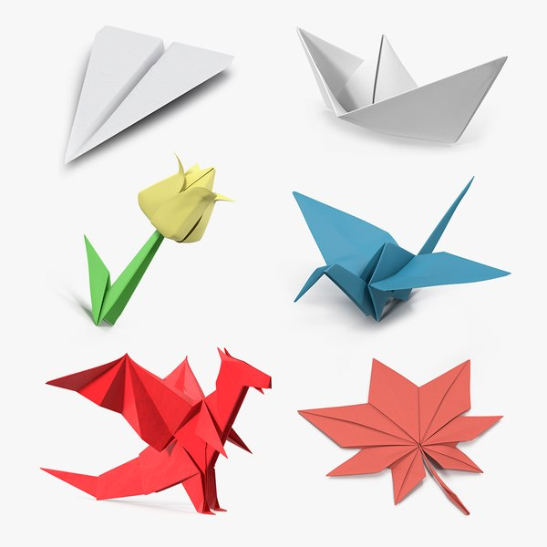
Origami and its Importance
What is Origami?
-Origami is the Japanese art of folding paper from a 2 dimensional plane into various shapes in the 3 dimensional realm.
Cultural Significance
-Origami carries deep cultural meaning, symbolizing values like peace, hope, and good fortune. The folding of paper cranes, for example, is a symbol of healing and resilience.
Educational and Therapeutic Benefits
-Origami promotes creativity, enhances problem-solving skills, and helps develop spatial reasoning. It also has therapeutic benefits, improving focus and reducing stress.

Slide 3
What is Ori(go)?
The overarching vision of my project is to develop an online database that catalogs transformational origami models, offering users the ability to collect and share the structures they construct in the real world.
Ori(go) will potentially be a cloud-based database of unique origami designs. These Origami structures are based on real world creations that can be digitally “unlocked” to possess the digital artifact.
The Ori(go) structures will be animated and will be produced from a crumpled piece of paper to a flat piece of paper to the desired/ unlocked Origami structure
Ori(go) will likely be a web devolved project where Origami structures will be based on the value of an Org which will be dependent on the difficulty and time taken to create a model

Slide 4
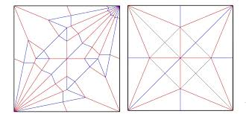
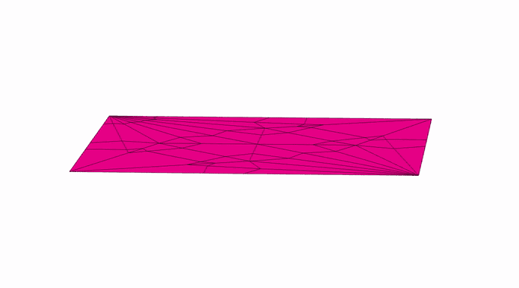
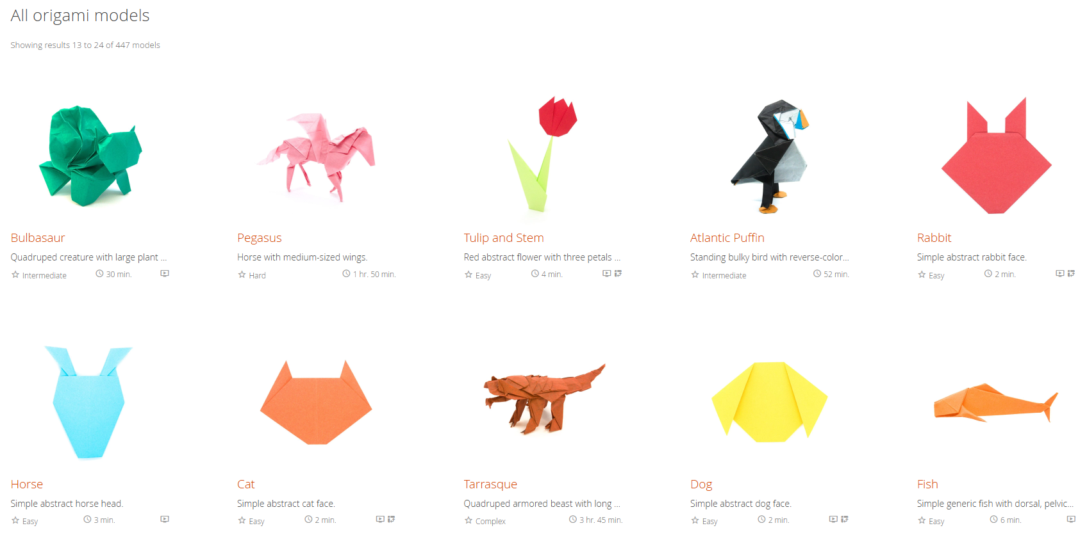

Crease patterns + Origami Simulator + Origami Database
How do Crease patterns work ?
Red = Mountain Fold
Blue = Valley Fold
How does the origami simulator function?
How does the current Origami Database function?
vertices_coords
edges_vertices
edges_assignment
faces_vertices

Slide 5

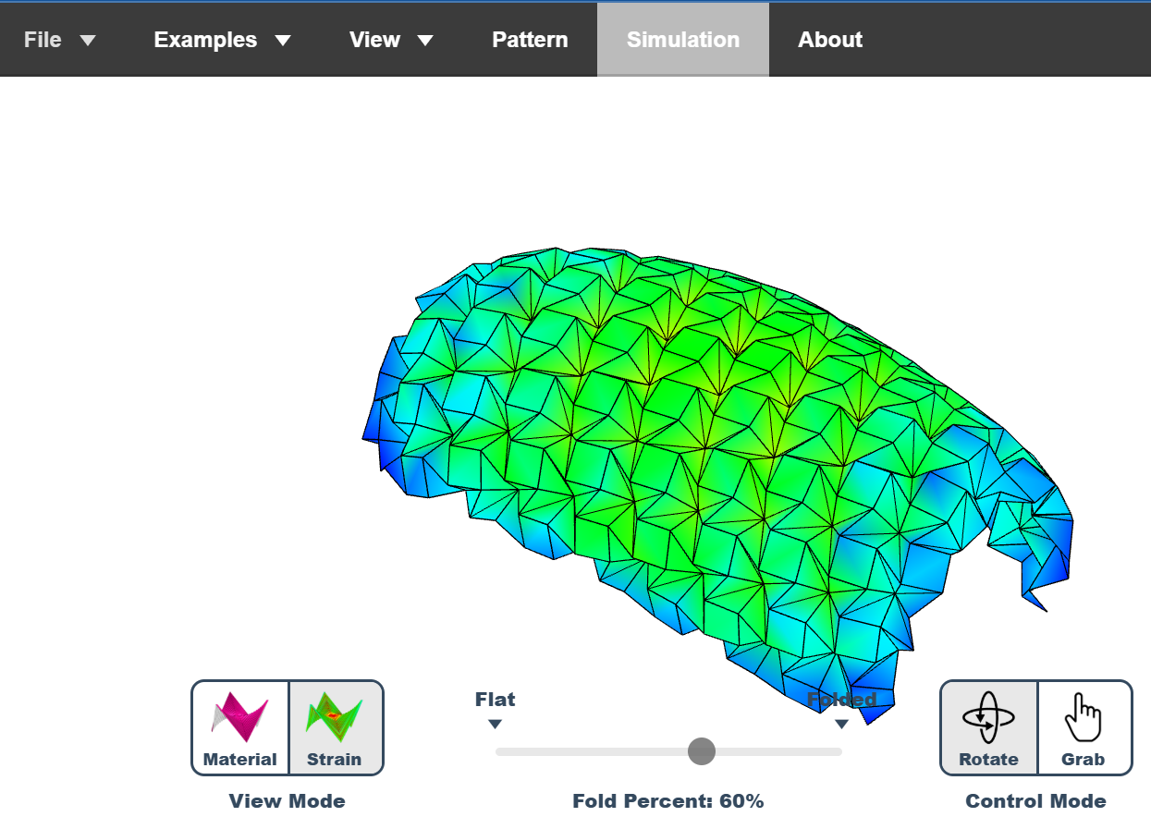

Slide 6
ETL Pipeline + Web development
Extract and Scrape Data from origami database
Transform Data and Wrangle Data
Load data into Python
Apply AI techniques to collect number of folds etc
Apply AI to provide complexity score
Develop Animations for other models
Integrate interactivity into website

Slide 7
Methodology
Here’s a breakdown of some tools and techniques I’ve used to bring this project’s vision to life:
🔍 𝗖𝗼𝗻𝘃𝗼𝗹𝘂𝘁𝗶𝗼𝗻𝗮𝗹 𝗡𝗲𝘂𝗿𝗮𝗹 𝗡𝗲𝘁𝘄𝗼𝗿𝗸𝘀 (𝗖𝗡𝗡): Utilized CNN to classify origami designs from an almost 𝟯𝟬𝟬𝟬 origami image dataset; model achieved a 𝟬.𝟳𝟭 accuracy score and a 𝟬.𝟲𝟴 recall rate. 🌳 𝗚𝗿𝗮𝗱𝗶𝗲𝗻𝘁 𝗕𝗼𝗼𝘀𝘁𝗶𝗻𝗴 𝗧𝗿𝗲𝗲𝘀 (𝗫𝗚𝗕𝗼𝗼𝘀𝘁, 𝗖𝗮𝘁𝗕𝗼𝗼𝘀𝘁, 𝗟𝗶𝗴𝗵𝘁𝗕𝗼𝗼𝘀𝘁): Implemented XGBoost, CatBoost, LightBoost and compared their accuracy and R-squared values. 📉 𝗩𝗮𝗹𝗶𝗱𝗮𝘁𝗶𝗼𝗻 𝗟𝗼𝘀𝘀 𝗣𝗹𝗼𝘁𝘀 : Tracked validation loss over continuous epochs allowing me to optimize CNN performance.

Slide 8
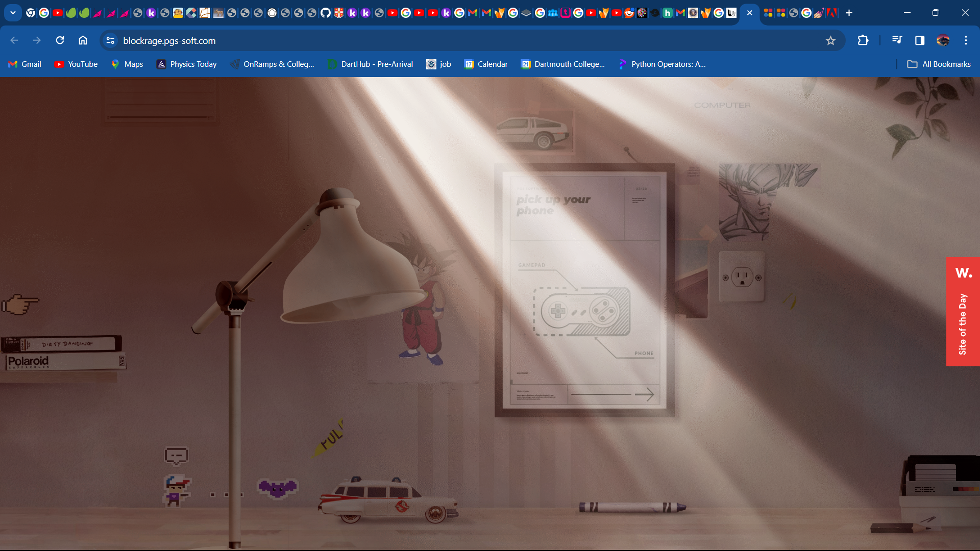



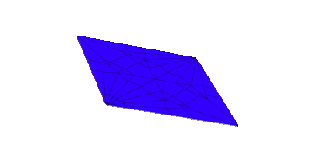
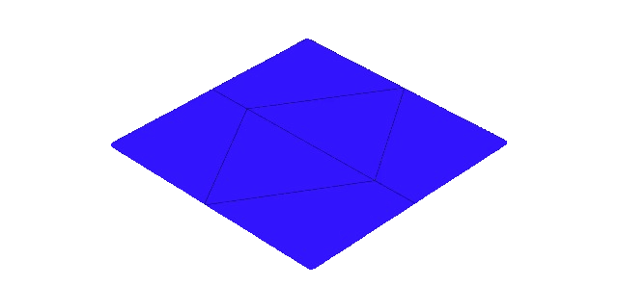
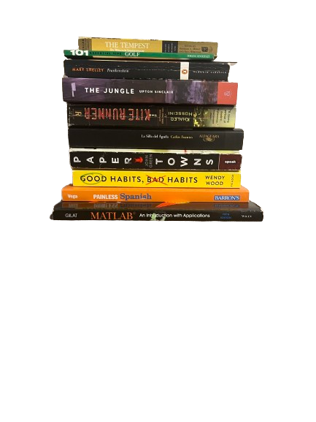
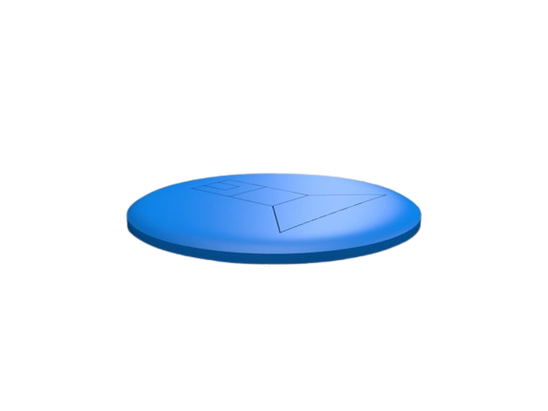


Model prototype
65
Structure: Crane
Model Number: 13592940EDEEEF30
Description: Abstract crane model with pyramid base
Difficulty: Moderate
Time Spent: 5 mins
Orgs: 65

Slide 9
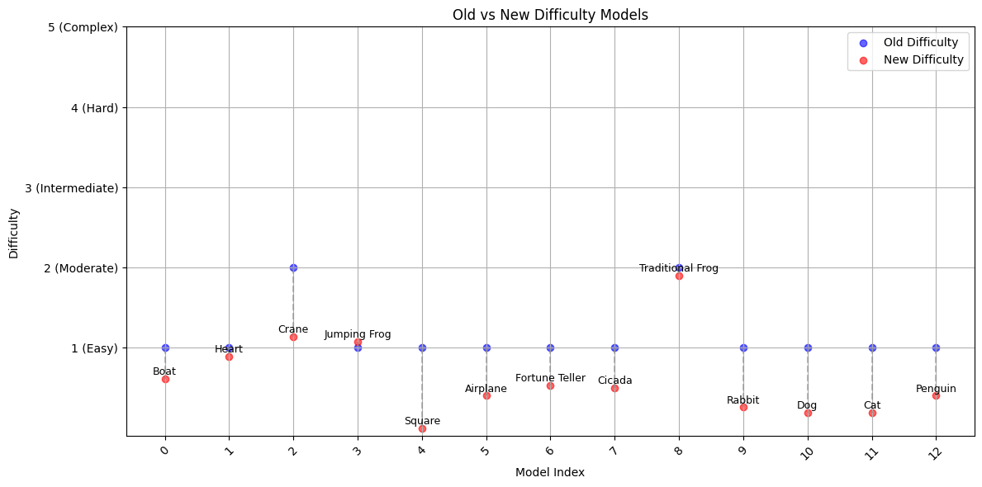
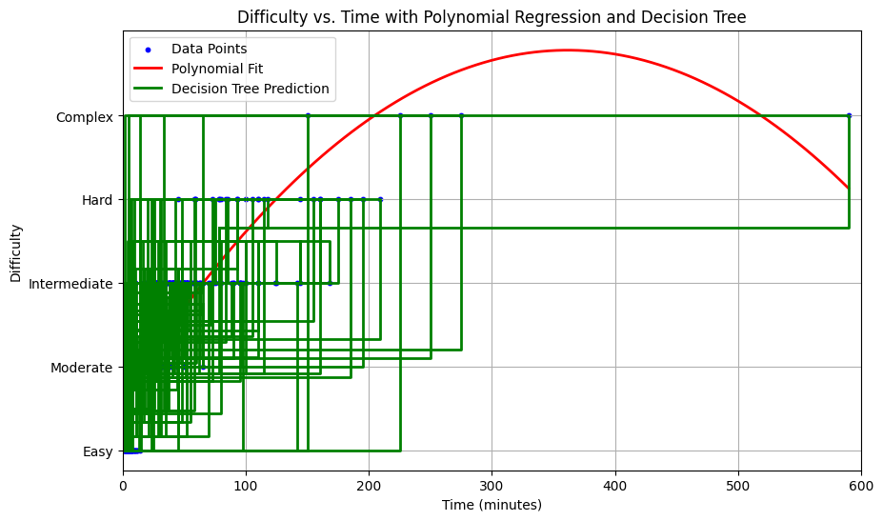
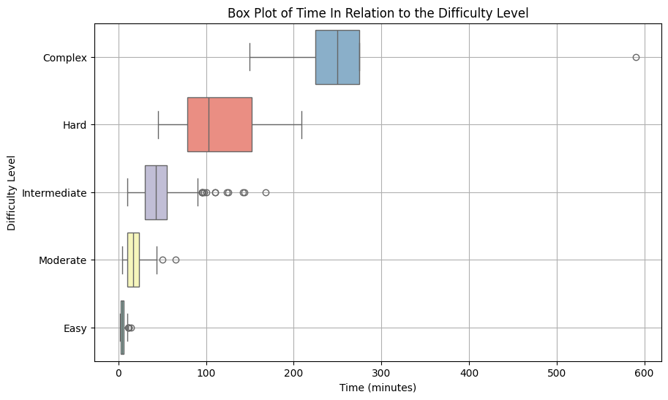
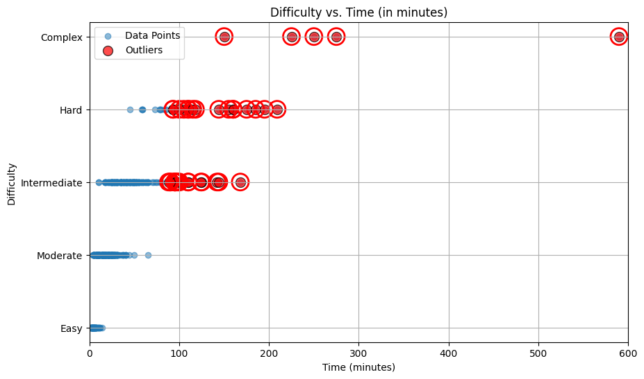
Plots and Visualizations
https://youtu.be/Gki6EYS-EhQ?t=39

Slide 10
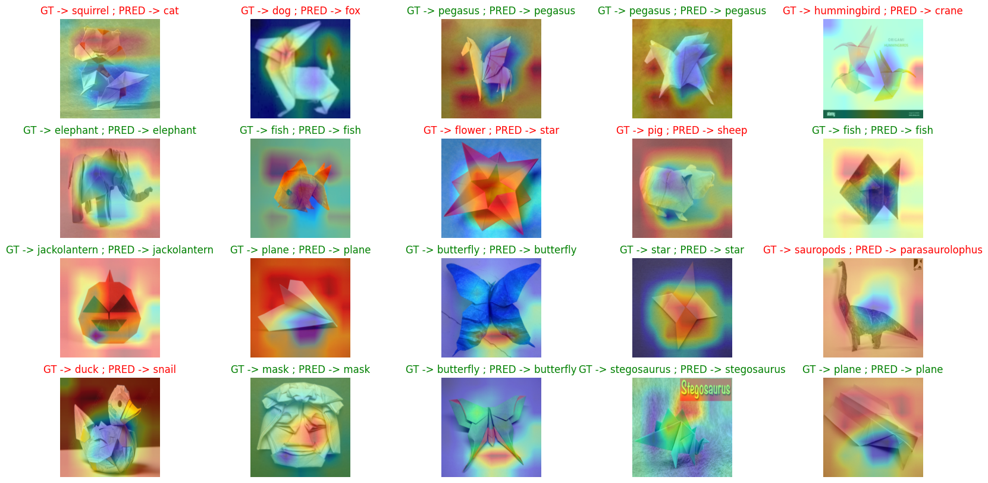
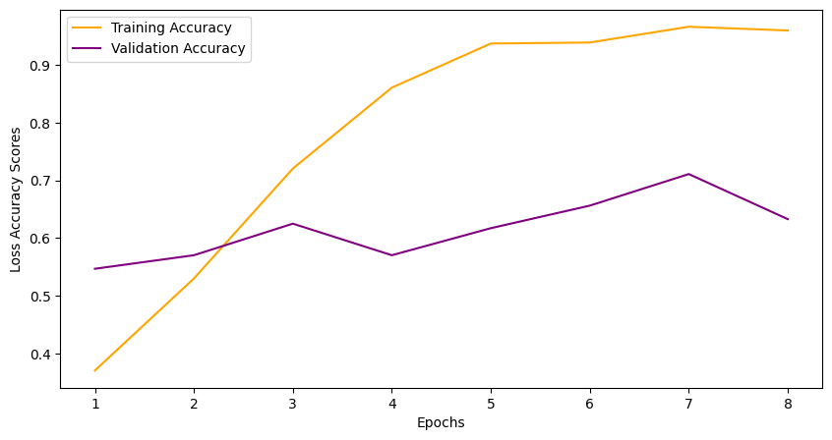
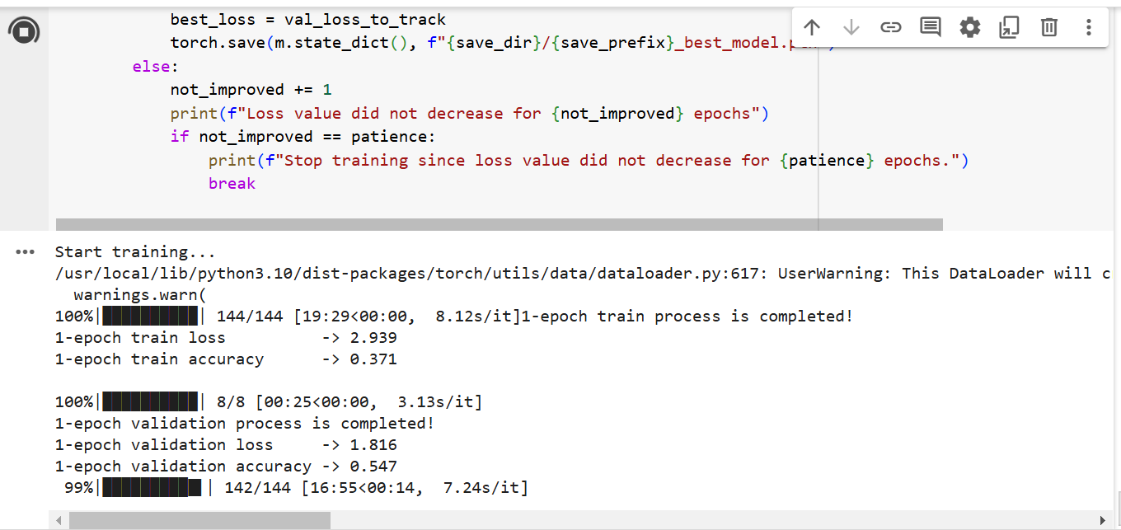
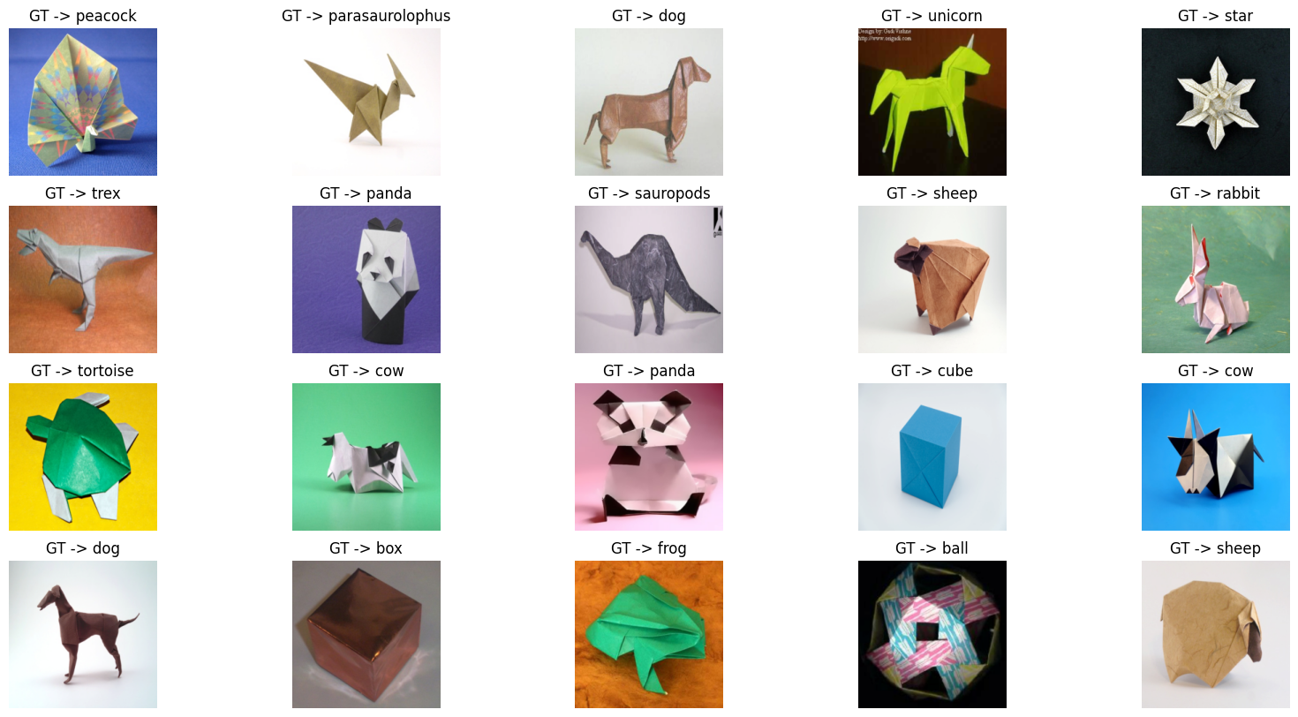
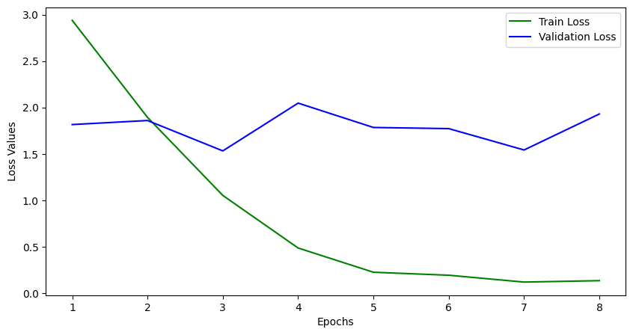
Plots and Visualizations

Slide 11


Features
In the beta release there will be at least 3 crumpled up pieces of paper of different colors and values.
The models for the structures will include an origami crane (3D), the lang cardinal model and the origami crane (flat). Currently working on origami folding algorithm that can generalize fold patterns for several models
Unique systematic features include the 3rd toggle feature representing whether the crumpled paper is on the platform or not (toggle to the right is on and toggle to the left is off)

Slide 12


Summary & Limitations
With the advent of technology, AI, and machine learning, we have entered the technological age. If an Idea exists online, it is timeless
Origami, simple in nature but imbued with mathematical design and symmetry based on the deconstruction of a 2d object to a 3d object allows people to rekindle their desire for geometry in motion
Design and the art of folding paper once thought to be ancient and obsolete has been remodeled to encompass ingenuity and sophistication.

Slide 13
What’s next ? Tasks in order:
Solidify and export batabase based in R into a csv
Solidify website design based on the 3 crumpled models
Produce toggle features for the 3 models
Provide hover feature text for all models
Produce click, hover, and return feature for the 3 models
Give the website an official domain
Finalize currency description and trademark names
Work on copyright feature*
Include more features and finalize PowerPoint

Slide 14
Resources
Origami Database - https://origami-2.database.com/models/ A comprehensive collection of origami models.
Origami Club - https://en.origami-club.com/index.html Provides diagrams and instructions for various origami creations.
Origami Classification Dataset - https://www.kaggle.com/datasets/karthikssalian/origami-models A dataset for classifying origami models, useful for research and analysis.
Origami Instructions - http://www.origami-instructions.com/ Offers step-by-step instructions for creating different origami models.
Origami Simulator - https://origamisimulator.org/ An online tool to simulate and visualize origami folding processes.
Social Cognitive Theory (Bandura, 1986) Bandura, A. (1986). Social Foundations of Thought and Action: A Social Cognitive Theory. Englewood Cliffs, NJ: Prentice Hall. A foundational text on social cognitive theory and its implications for learning.
Experiential Learning (Kolb, 1984) Kolb, D. A. (1984). Experiential Learning: Experience as the Source of Learning and Development. Prentice Hall. Discusses the role of experience in learning and development.
Mathematical Implications of Origami (Tadashi Tokieda, Stanford) Tadashi Tokieda, A World From a Sheet of Paper, Stanford, October 4th, 2024. A lecture exploring the geometric and mathematical aspects of origami.
Symbolism of Origami - https://libguides.cmich.edu/c.php?g=1217908 A guide to the symbolism and cultural meanings behind various origami figures.

Slide 15


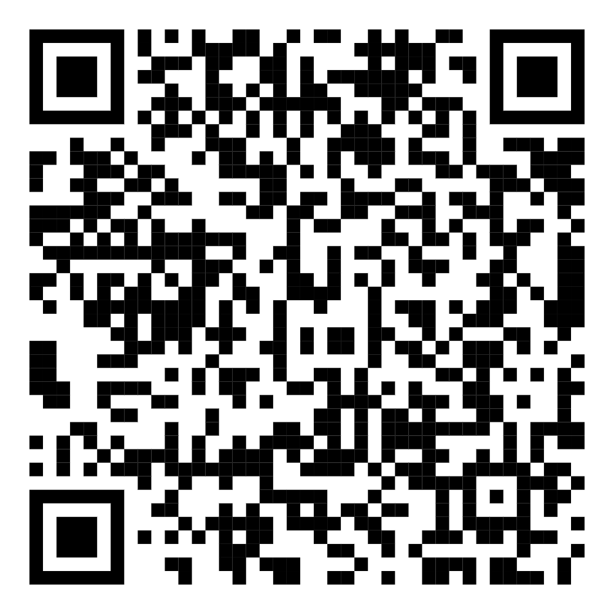
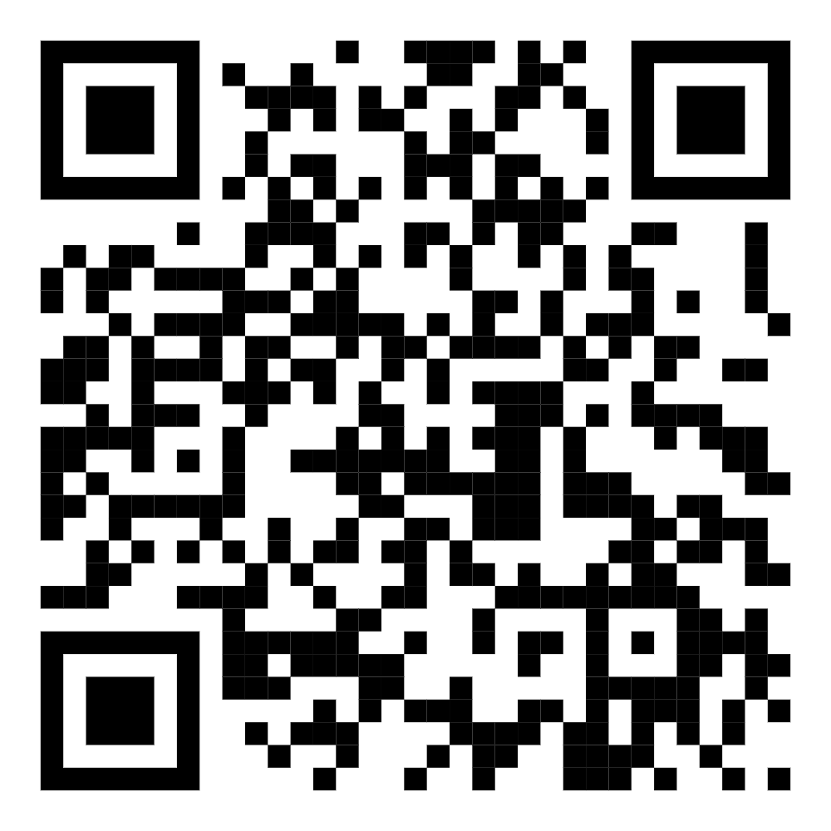
Thank You for Listening
Data Science Portfolio
LinkedIn

